Slide 1
CPU SCHEDULING ALGORITHM
By-
N Prabhu(1BM19IS096)
Manjunath kallatti (1BM19IS086)

Slide 2
Problem Statement
CPU SCHEDULING
Implement a framework for CPU scheduling with three scheduling algorithms: FIFO, round robin, and shortest job first (SJF).

Slide 3
INTRODUCTION
CPU Scheduling is a process of determining which process will own CPU for execution while another process is on hold. The main task of CPU scheduling is to make sure that whenever the CPU remains idle, the OS at least select one of the processes available in the ready queue for execution.
First Come First Serve
First Come First Serve is the full form of FCFS. It is the easiest and most simple CPU scheduling algorithm. In this type of algorithm, the process which requests the CPU gets the CPU allocation first. This scheduling method can be managed with a FIFO queue.

Slide 4
Shortest Job First
SJF is a full form of (Shortest job first) is a scheduling algorithm in which the process with the shortest execution time should be selected for execution next. This scheduling method can be preemptive or non-preemptive. It significantly reduces the average waiting time for other processes awaiting execution.
Round-Robin Scheduling
Round robin is the oldest, simplest scheduling algorithm. The name of this algorithm comes from the round-robin principle, where each person gets an equal share of something in turn. It is mostly used for scheduling algorithms in multitasking. This algorithm method helps for starvation free execution of processes.

Slide 5
CONCEPTS USED:
Classes and Objects
Encapsulation
Abstraction
Inheritance
Polymorphism
Packages and Interfaces
Exception handling
Multithreaded programming
Collections Framework
Swing

Slide 6
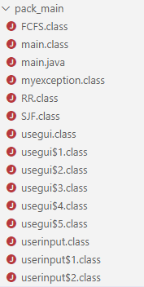
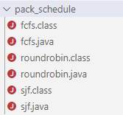
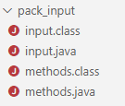
PROGRAM OVERVIEW

Slide 7
FLOW CHART
START
FCFS ALGO
main()
User input
Object for GUI created
ROUNDROBIN ALGO
END
Number of processes
Random input
SJF ALGO

Slide 8
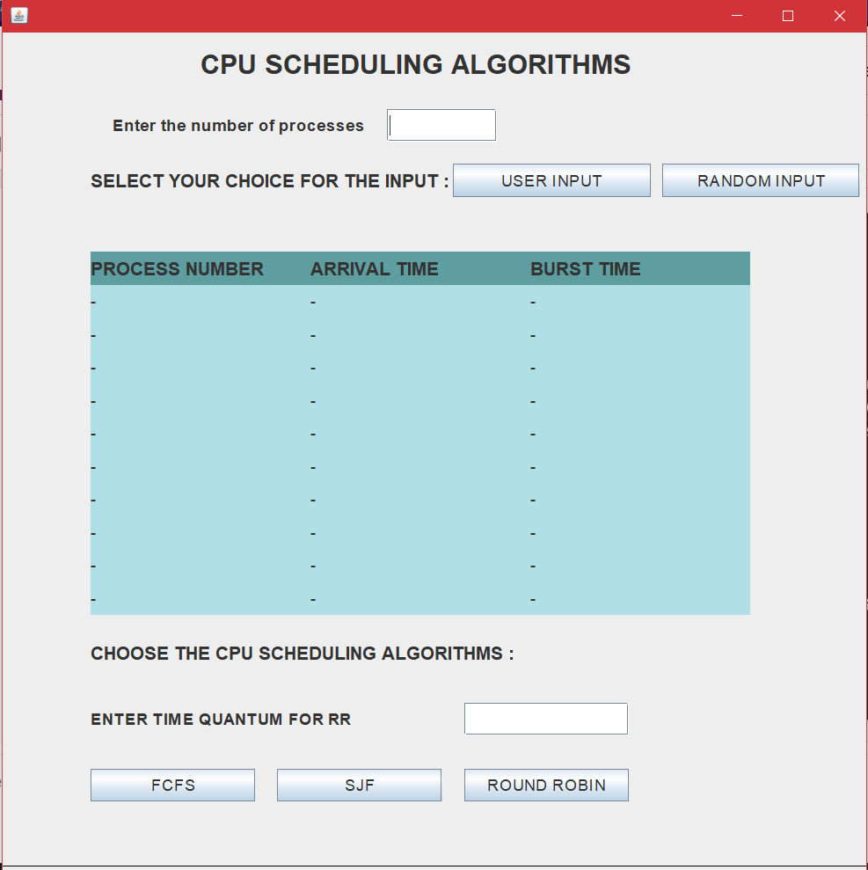
OUTPUT

Slide 9
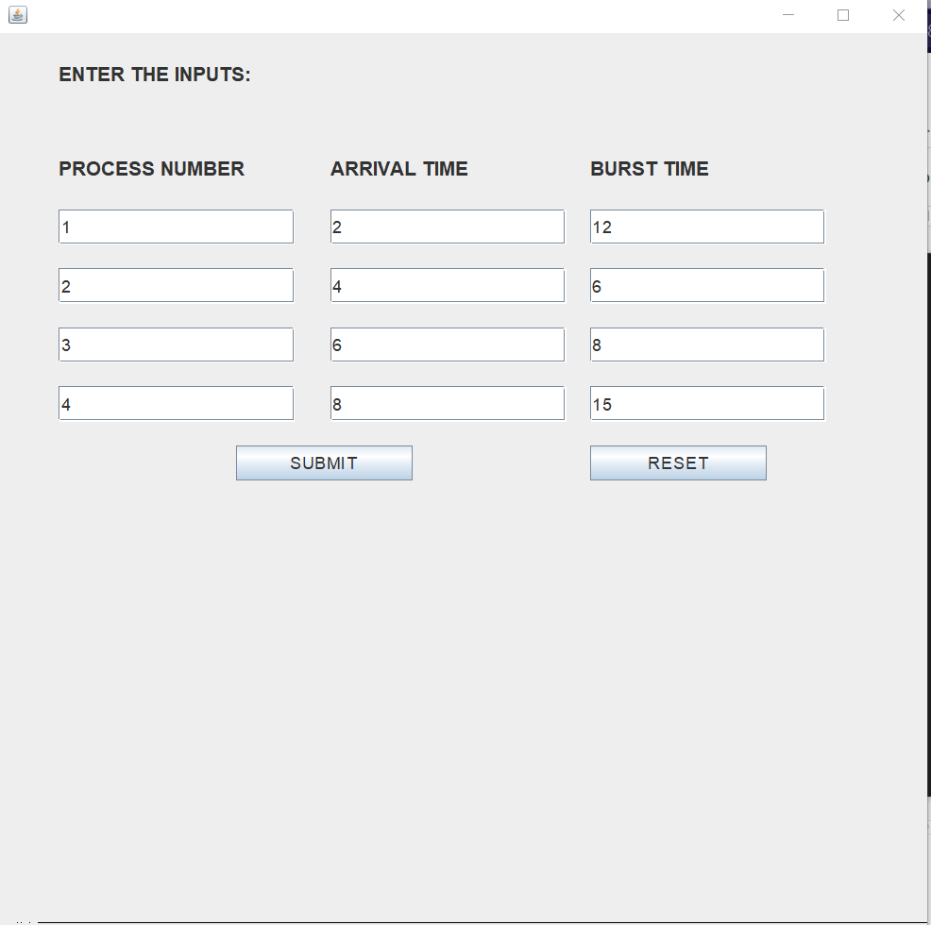
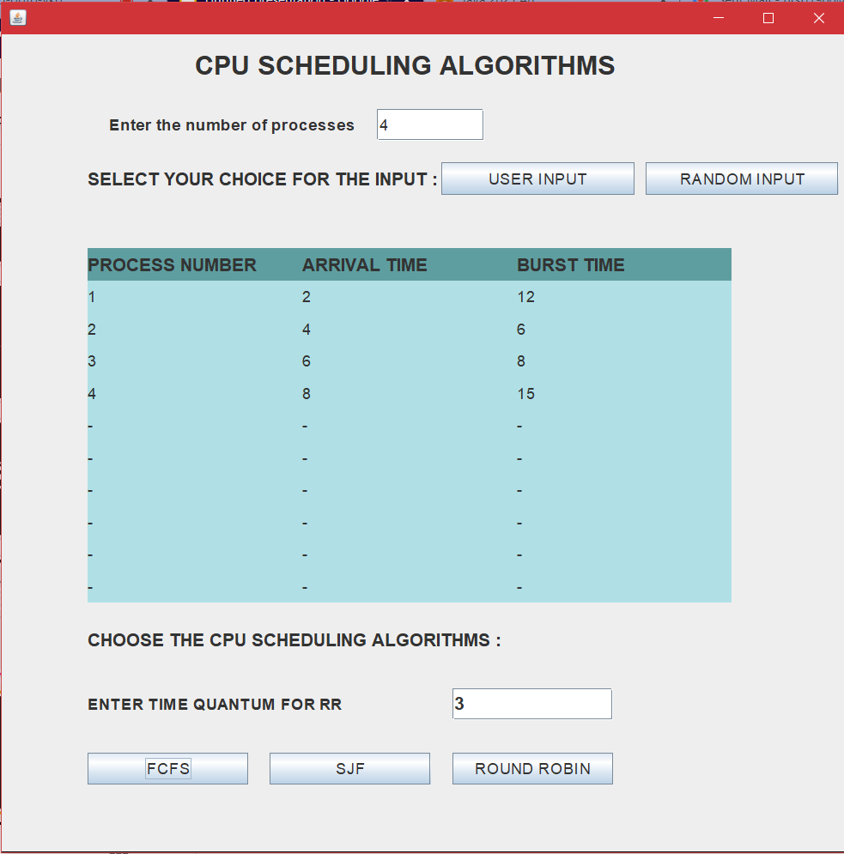
SUBMIT

Slide 10
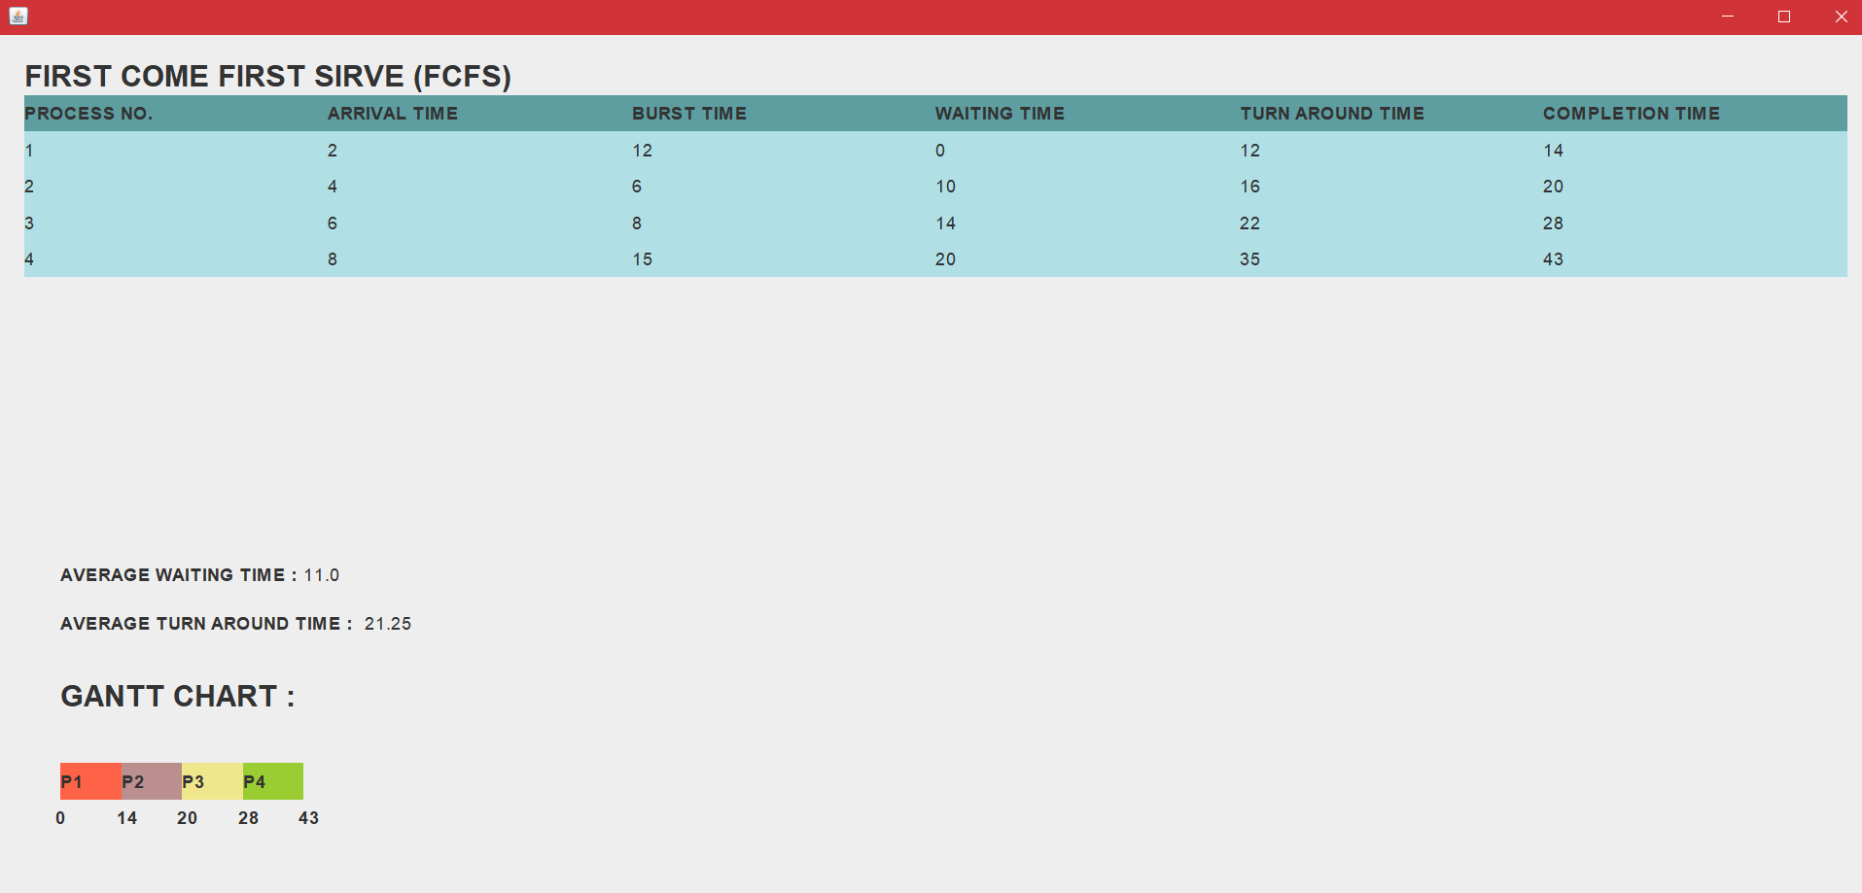

Slide 11
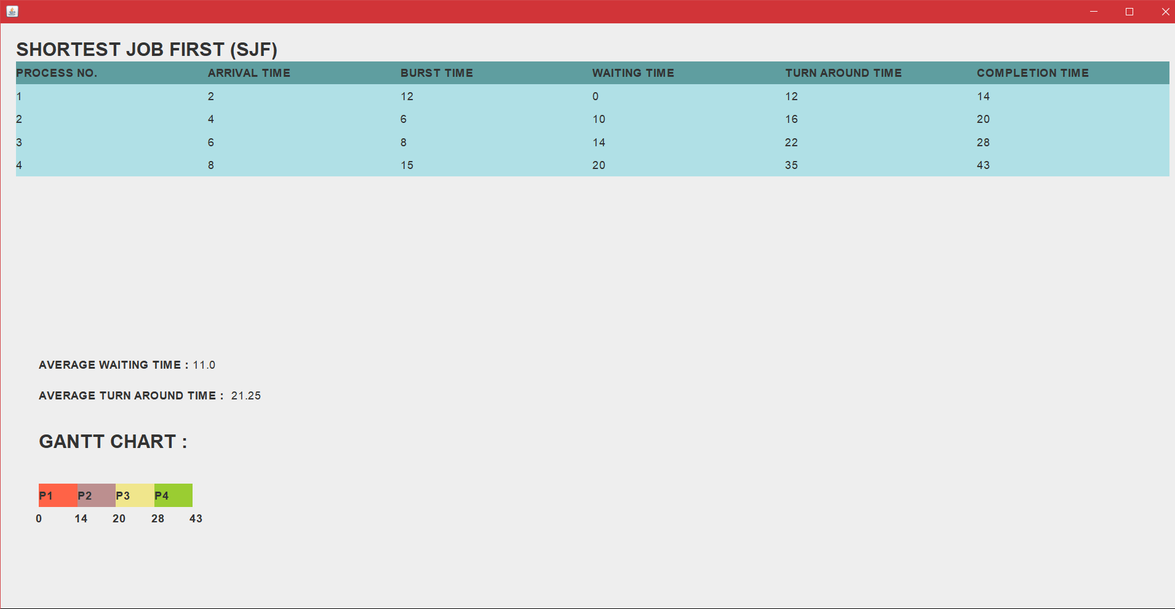

Slide 12
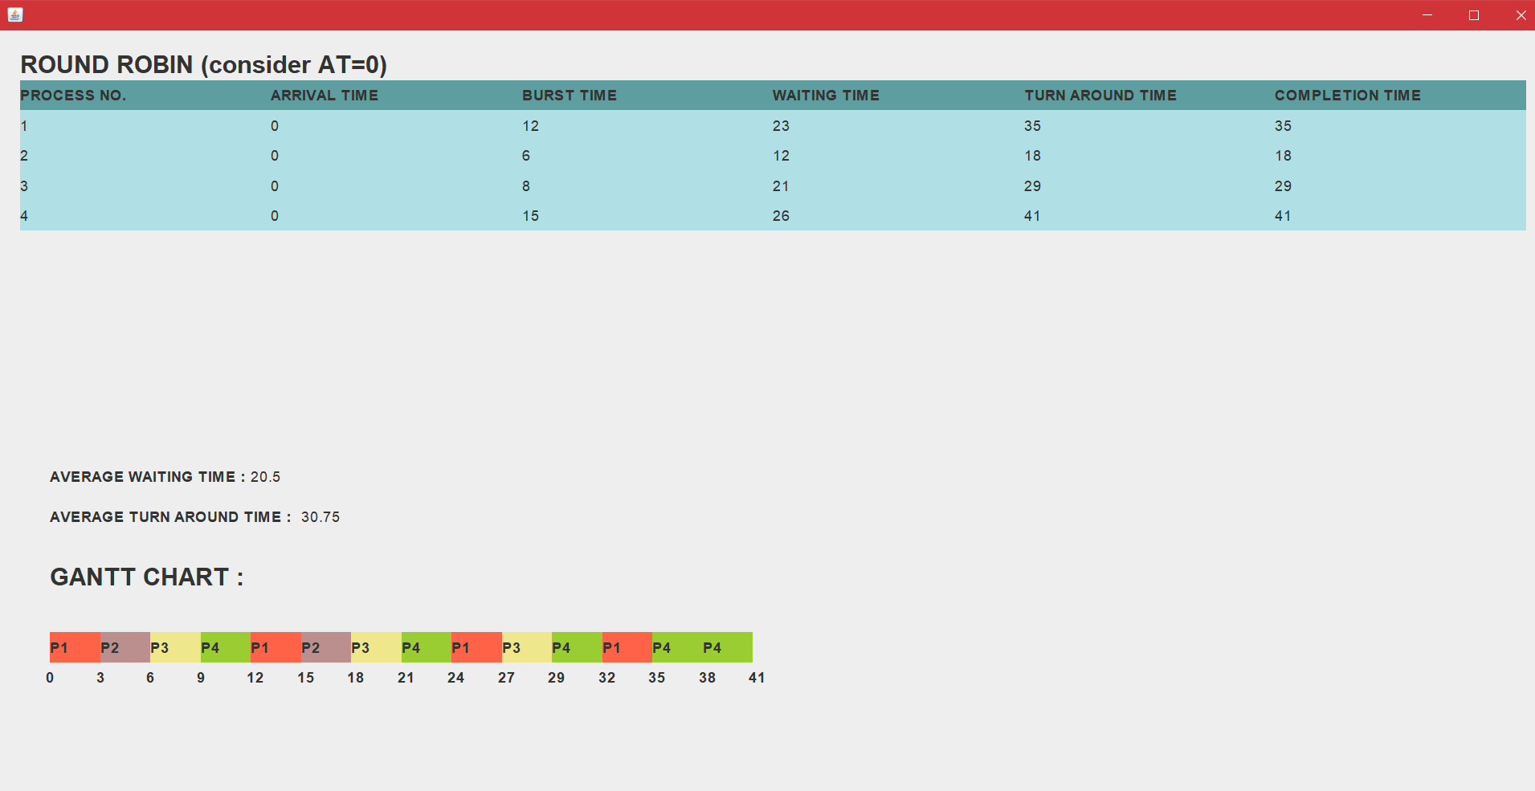

Slide 13
THANK YOU😄

